Slide 1
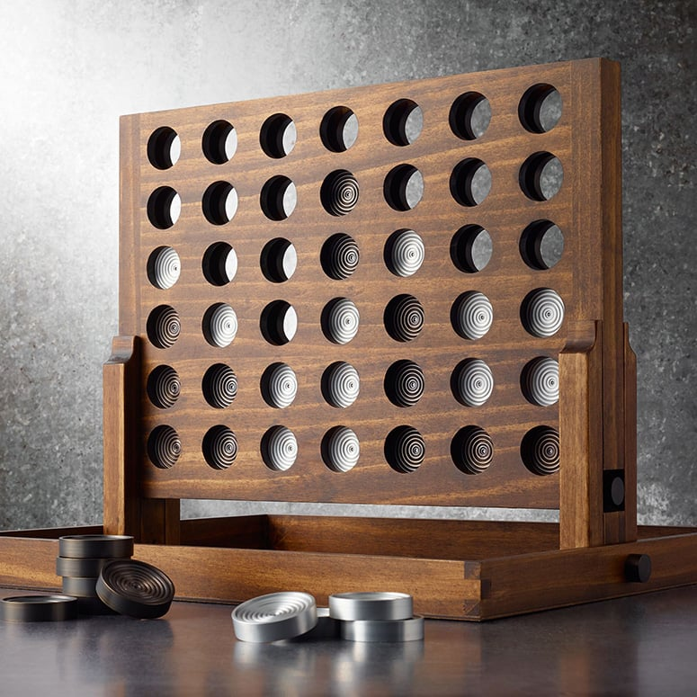
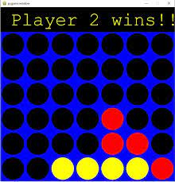
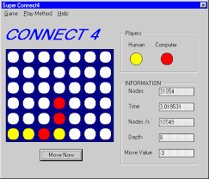
Connect 4 Board Game
My Connect 4 Boardgame is a classic childhood game that brings back so many great memories.
The objective of the game is to be the first to form a horizontal, vertical or diagonal line of 4 of one’s own token. 2 Player game.
I want to add changes to my code so the game can be more modern and challenging.
GitHub Repository
Nyah Robinson

